Slide 1
Wanna last “longer“ in professional nba

Slide 2
Guide-instruction
PHYSICAL
HEIGHTS & WEIGHTS
POSITION
AGE OF DRAFT AND RETIRE
TECHNIQUE
SKILL-SET RATIO FOR EACH POSITION
PERFORMANCE STATS

Slide 3
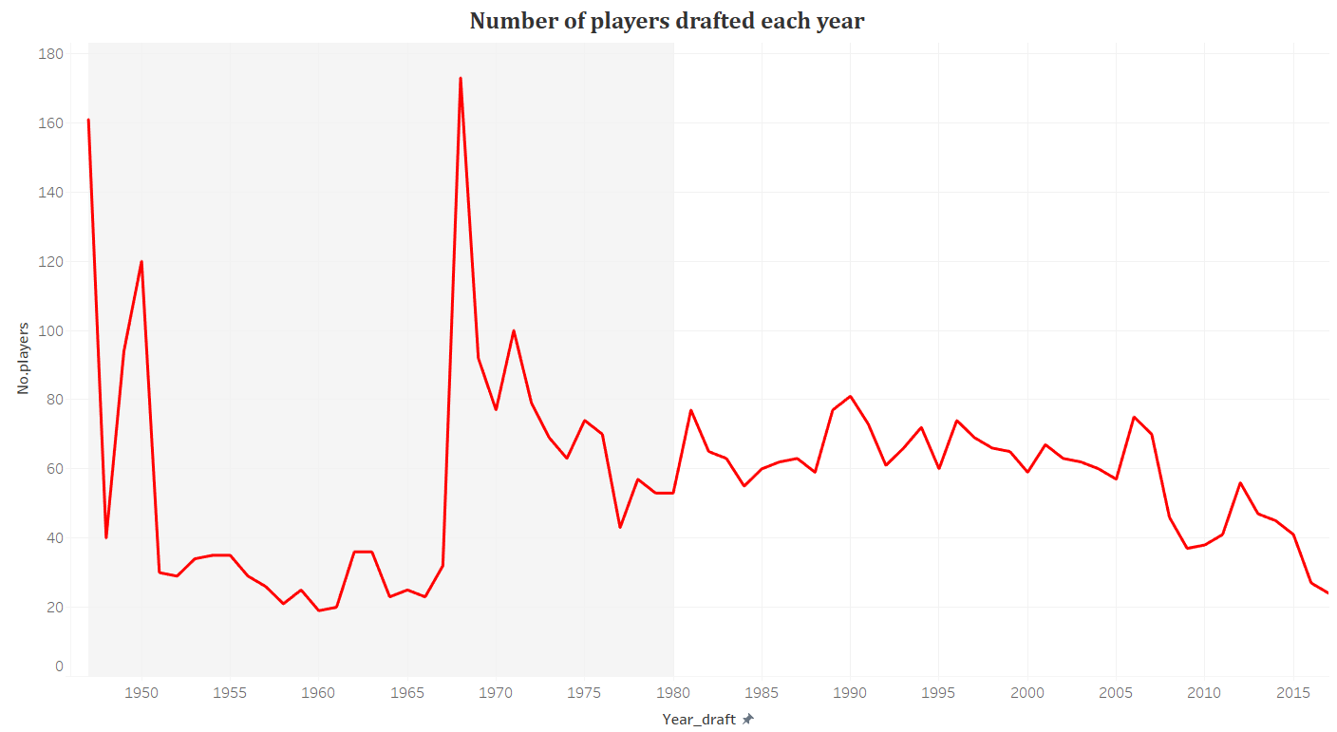
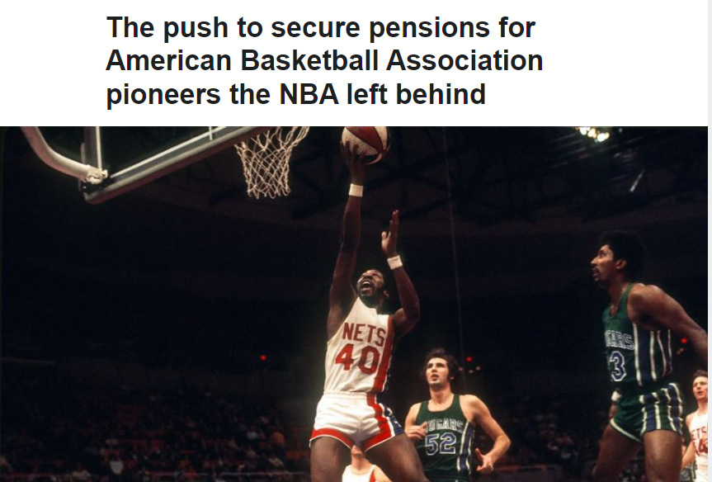
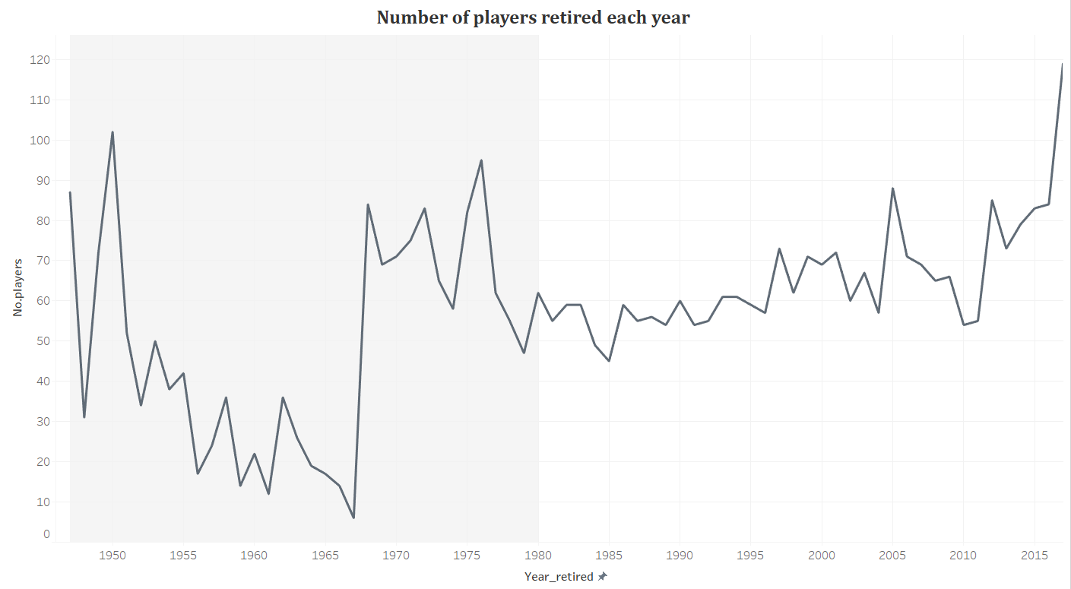
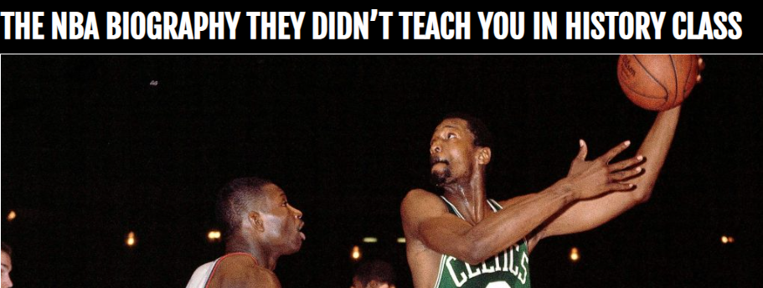
"The 1960s reverberated with the Vietnam War and Civil Rights overshadowing most everything else. Professional athletes contending for their “rights” was hardly a subject of much sympathy.”
"It was definitely an unspoken rule," said Maurice McHartley, an ABA player from 1957 to 1970 who is Black. "It wasn't because brothers couldn't play. ... The NBA at that particular time was more of a white league, so to speak. ... "The economic situation in pro basketball in the mid-'70s was horrible. They almost drove each other out of business. This is what happens when leagues are in distress: No one is thinking long term,"."

Slide 4
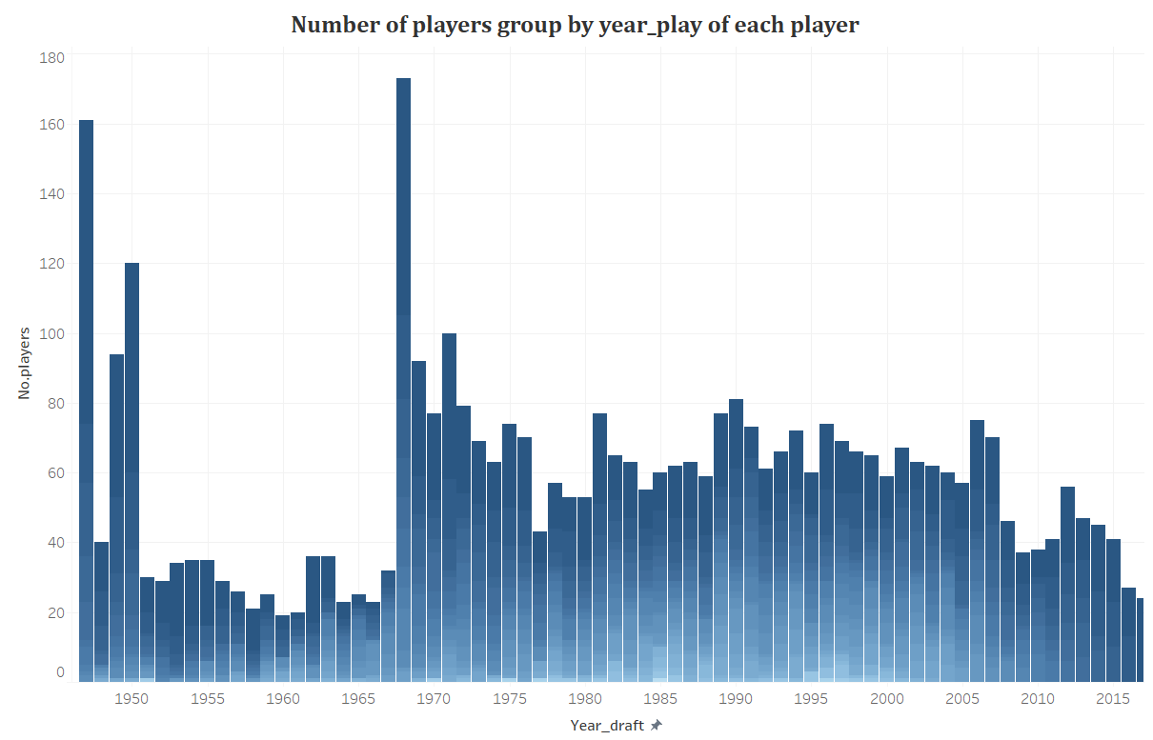
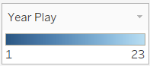
Period(1945-1970)
mean 4.303852
std 3.954124
min 1
25% 1
50% 3
75% 7
max 21
Period(1970-2017)
mean 6.116647
std 4.755934
min 1
25% 2
50% 5
75% 10
max 23

Slide 5
2 GROUPS:
NBA
GROUP 1
LAST LESS THAN 3-YEAR
GROUP 2
LAST “LONGER” THAN 3-YEAR
PERIOD 1980-2017

Slide 6
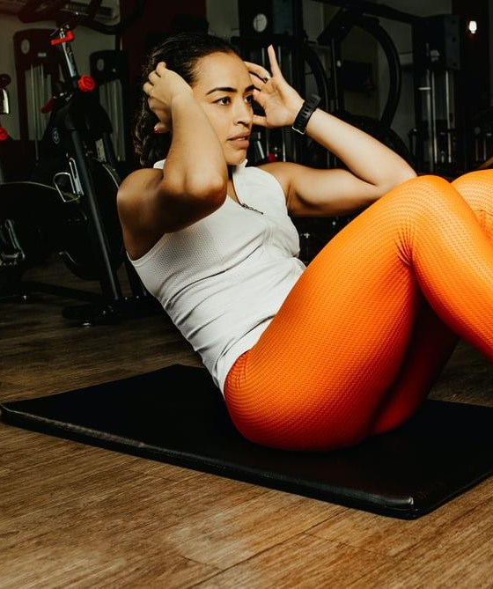
PHYSICALS
HEIGHTS & WEIGHTS
POSITION
AGE OF DRAFT AND RETIRE

Slide 7
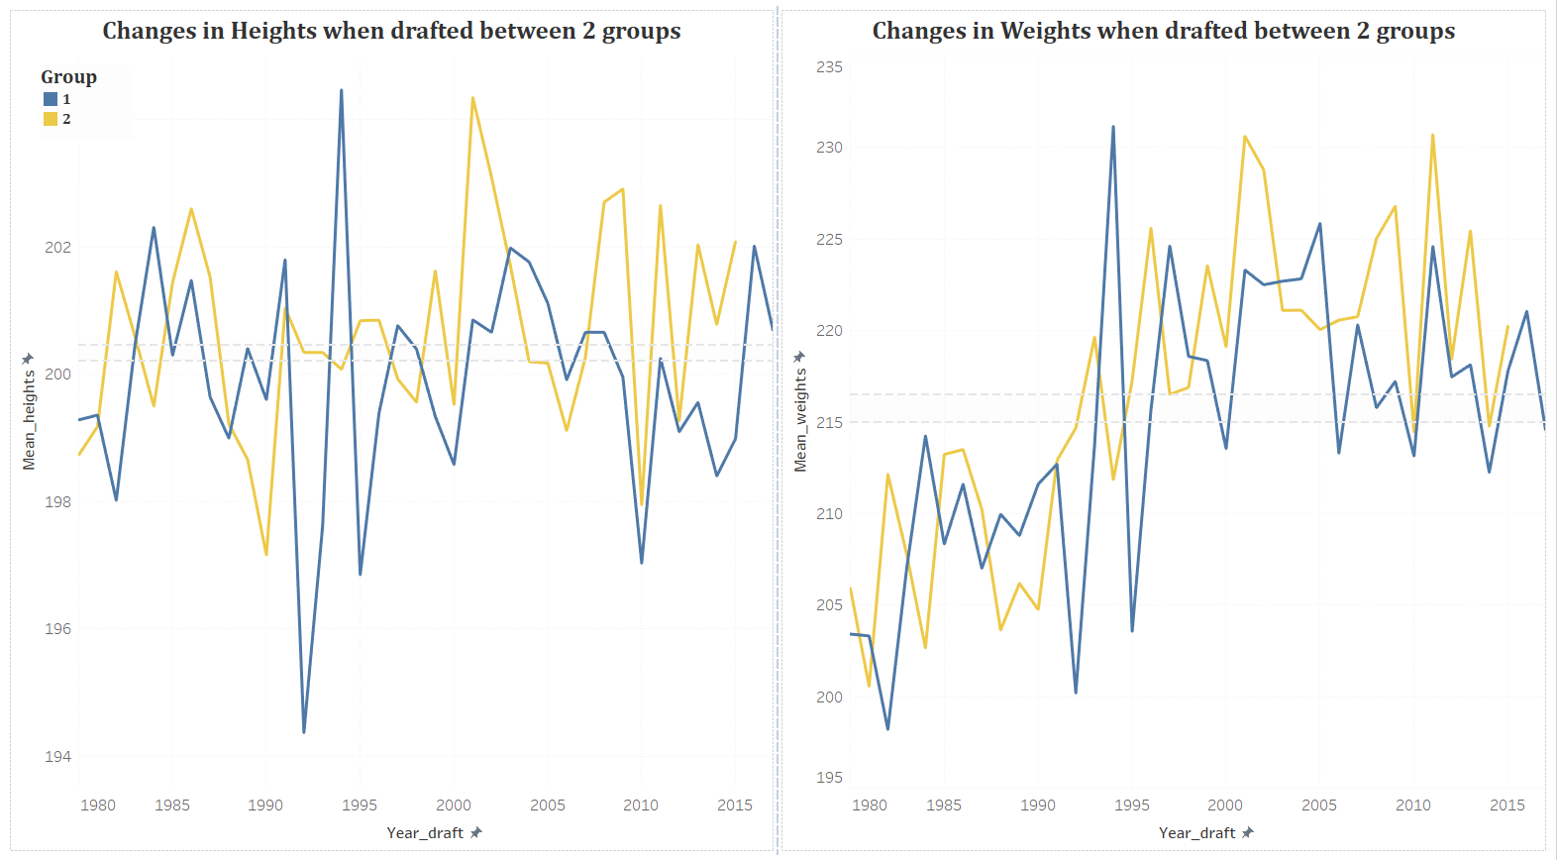

Slide 8
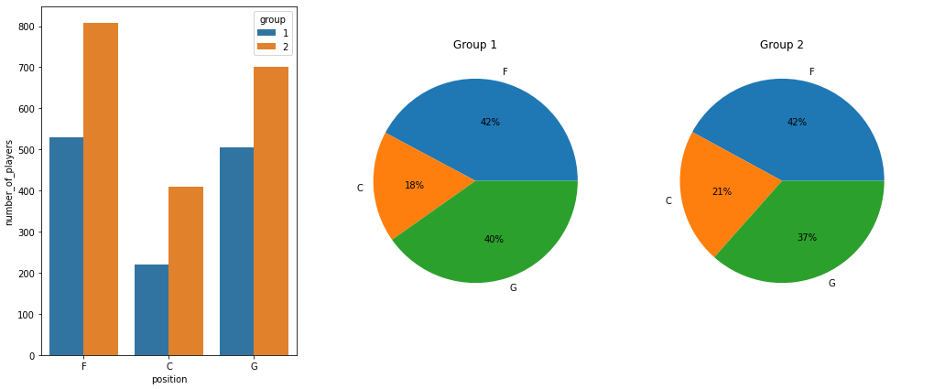
DISTRIBUTION OF NO.PLAYERS’ POSTION IN EACH GROUP

Slide 9
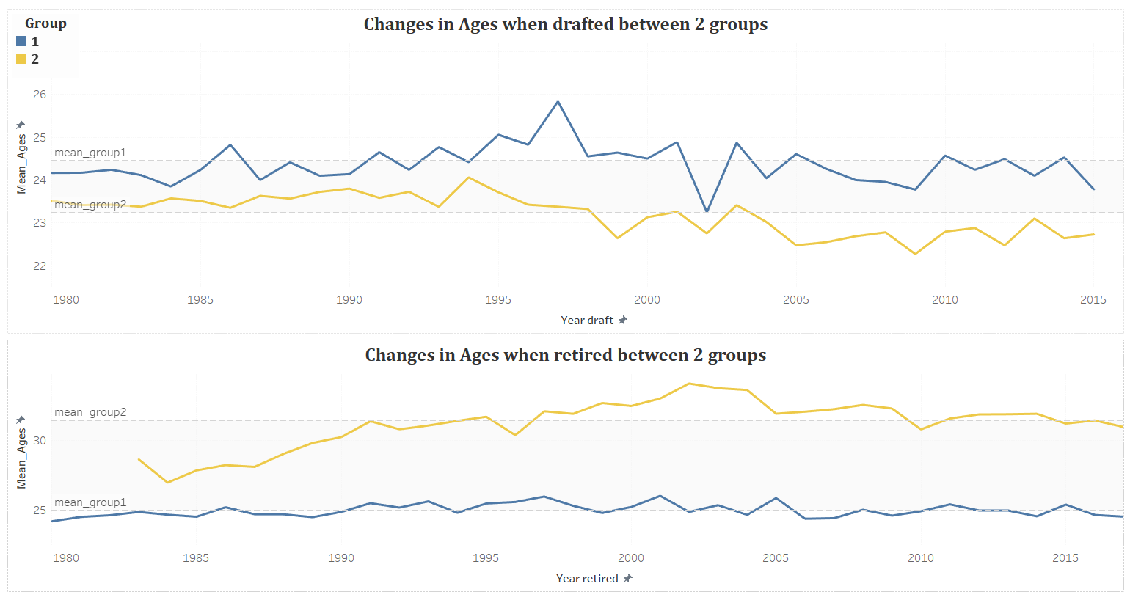
INSIGHT
The LATER you start
The SOONER you ‘stop-lasting’

Slide 10
TECHNIQUE
SKILL-SET RATIO FOR EACH POSITION
PERFORMANCE STATS

Slide 11
AST Assist
STL Steal
3P 3-point
TOV Turnover
BLK Block
DRB Defense rebound
ORB Offense rebound
FT Free-throws
2P 2-point
TRB Total rebound
References
Zongpeng Zhai (2020).”Explaining Positional Differences of Performance Profiles for the Elite Female Basketball Players”
Front Psychol. 2020; 11: 558750.
Published online 2021 Jan 13. doi: 10.3389/fpsyg.2020.558750

Slide 12
AST Assist
STL Steal
3P 3-point
TOV Turnover
BLK Block
DRB Defense rebound
ORB Offense rebound
FT Free-throws
2P 2-point
TRB Total rebound
References
Zongpeng Zhai (2020).”Explaining Positional Differences of Performance Profiles for the Elite Female Basketball Players”
Front Psychol. 2020; 11: 558750.
Published online 2021 Jan 13. doi: 10.3389/fpsyg.2020.558750

Slide 13

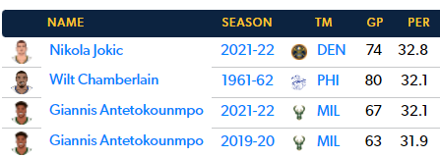
‘Per’
NBA Player Efficiency Rating

Slide 14
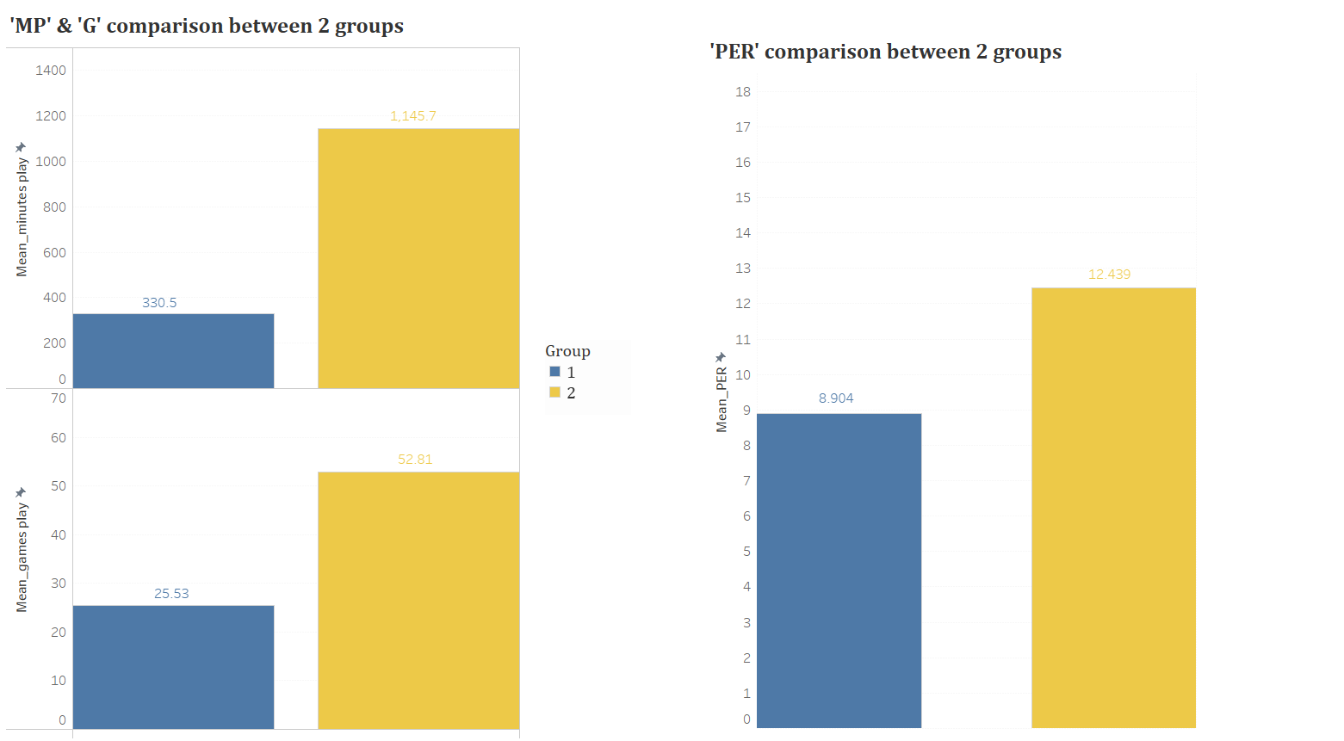

Slide 15
24- year-old?

Slide 16
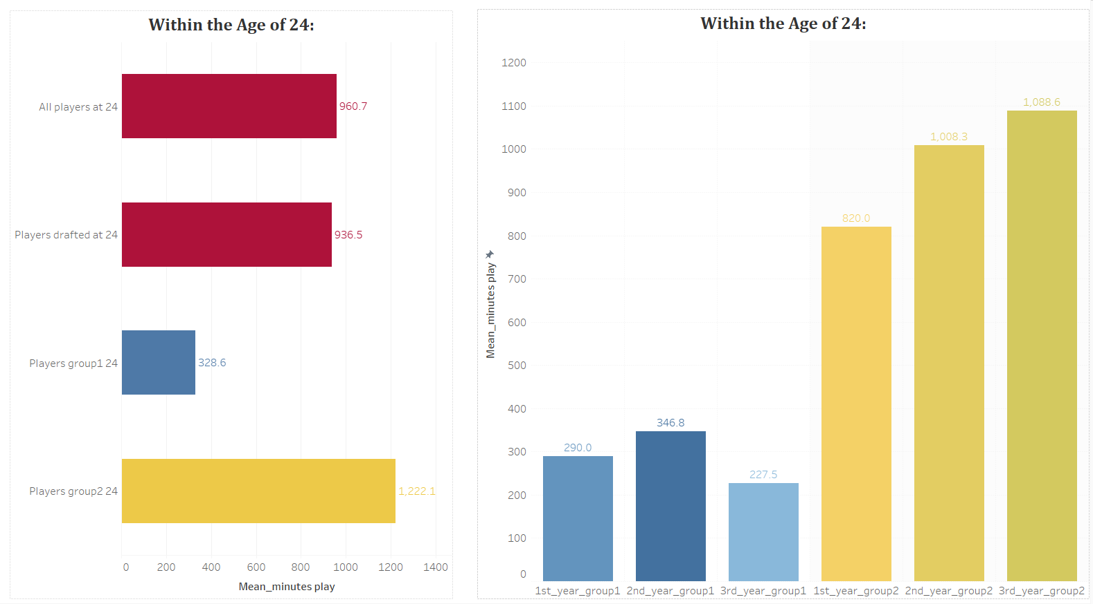
Mean_MP when they 24-year-old
Mean_MP of 24-year-old-drafted for 3-starter-year

Slide 17
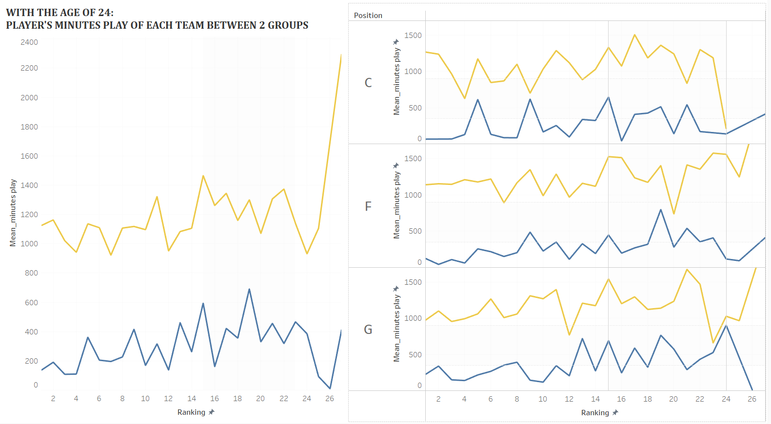

Slide 18
< 24 years old
Play guard in low-ranking team
9X%
Wanna last longer?
Just turn 24?
Total success!

Slide 19

THANK you!
Thank me? NO

